Slide 1
Information Theory
CSCI 4360/6360 Data Science II

Slide 2



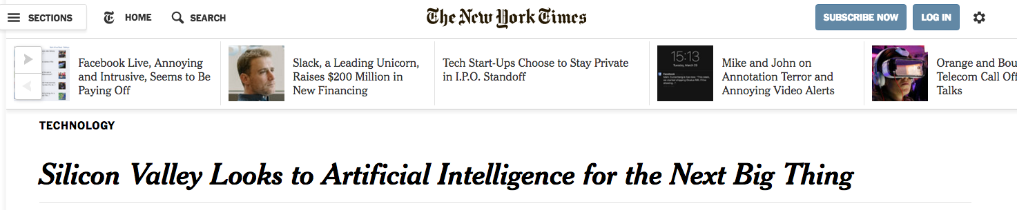

Slide 3



Slide 4
Explain Your Deep Network
For facial recognition
What do the weights mean?
For scene segmentation
For multitask learning
For autoencoders

Slide 5
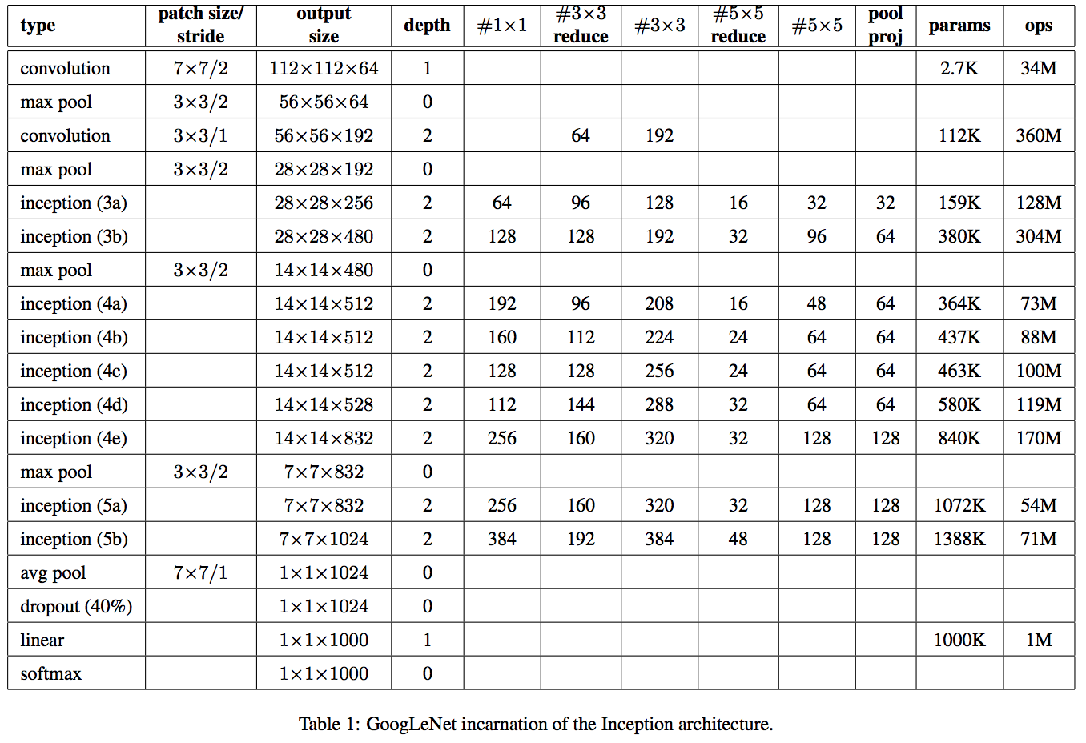
Biggest Drawback of Deep Learning
Interpretability
Explain what is being learned at layer 47, weight 301
What is layer 25 learning?
What determines the network’s decision-making process for a given input?
GoogLeNet architecture

Slide 6
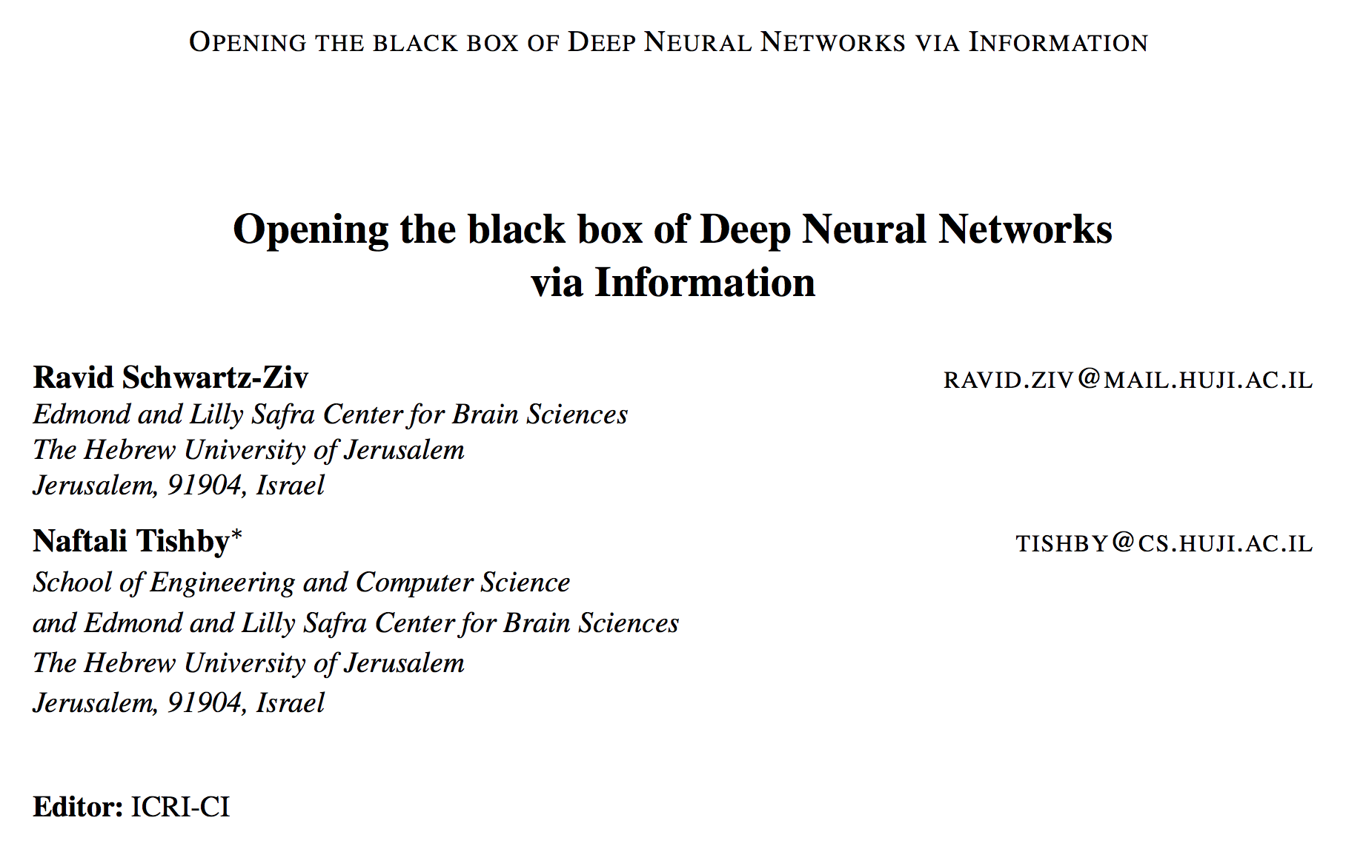
Information-Theoretic Perspective

Slide 7
Information Theory
Dr. Claude Shannon
Outlined in 1948 paper, “A Mathematical Theory of Communication”
The “Father of Information Theory”
Information: set of possible messages
Sent over a noisy channel
Receiver reconstructs messages with low probability of error
Revolutionized digital communication via compression

Slide 8
Information Theory
Communication
Information retrieval
Intelligence gathering
Signal processing
Gambling
Statistics
Cryptography
Music composition

Slide 9
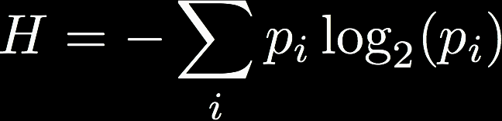
Information Theory
Basic unit of information is the bit
Not necessarily 1s and 0s, but often takes that incarnation in practice
Entropy
Units of bits per symbol
Quantifies uncertainty in [discrete] random variable

Slide 10

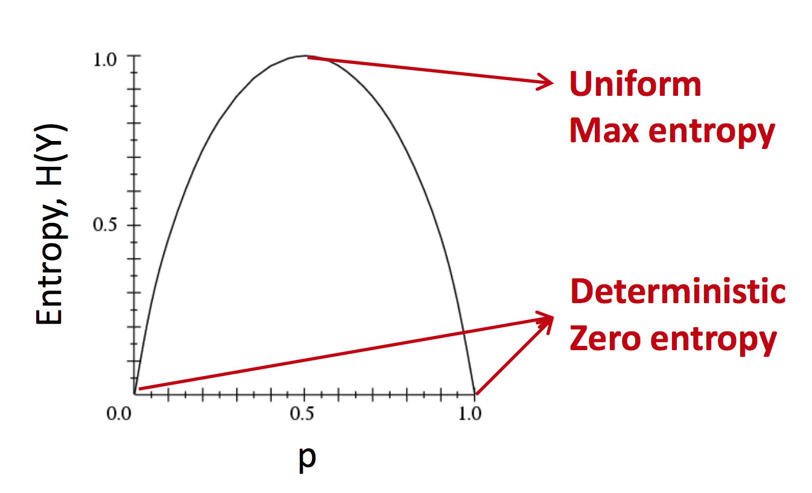
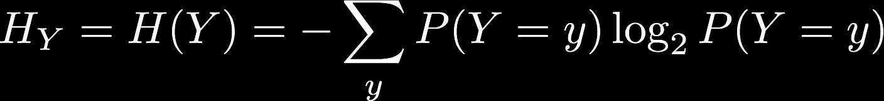
Entropy
Can be written in terms of a random variable, Y
More uncertainty = Higher entropy

Slide 11
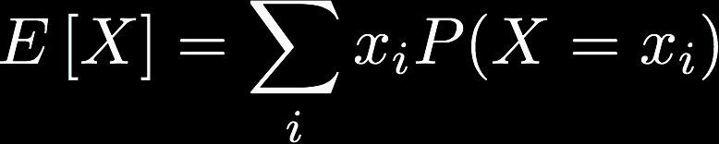
Entropy
H(Y) is the expected number of bits needed to encode a randomly-drawn value of Y (assuming the most efficient code)
Definition of expected value

Slide 12
Joint Entropy
Symmetric
H(X, Y) is the entropy of the pairing of X and Y
If X and Y are independent, H(X, Y) = H(X) + H(Y)
Not to be confused with cross-entropy
Average number of bits needed to identify an event as having come from either X or Y
D is the KL divergence
(why the notations are the same… no idea)
Asymmetric

Slide 13
Conditional Entropy
Also called equivocation
Like conditional probability, a basic property emerges with respect to the joint and marginal entropies

Slide 14
Mutual Information
Which all gives rise to the concept of mutual information: how much information you can obtain about one random variable by observing another
If this is 0, knowing Y tells us nothing about X
Uncertainty in X
Uncertainty in X, given we have observed Y

Slide 15
Mutual Information
Notes:
The area contained by both circles is the joint entropy Η(X,Y).
The circle on the left (red and violet) is the individual entropy Η(X),
with the red being the conditional entropy Η(X|Y).
The circle on the right (blue and violet) is Η(Y), with the blue being Η(Y|X).
The violet is the mutual information I(X;Y).

Slide 16
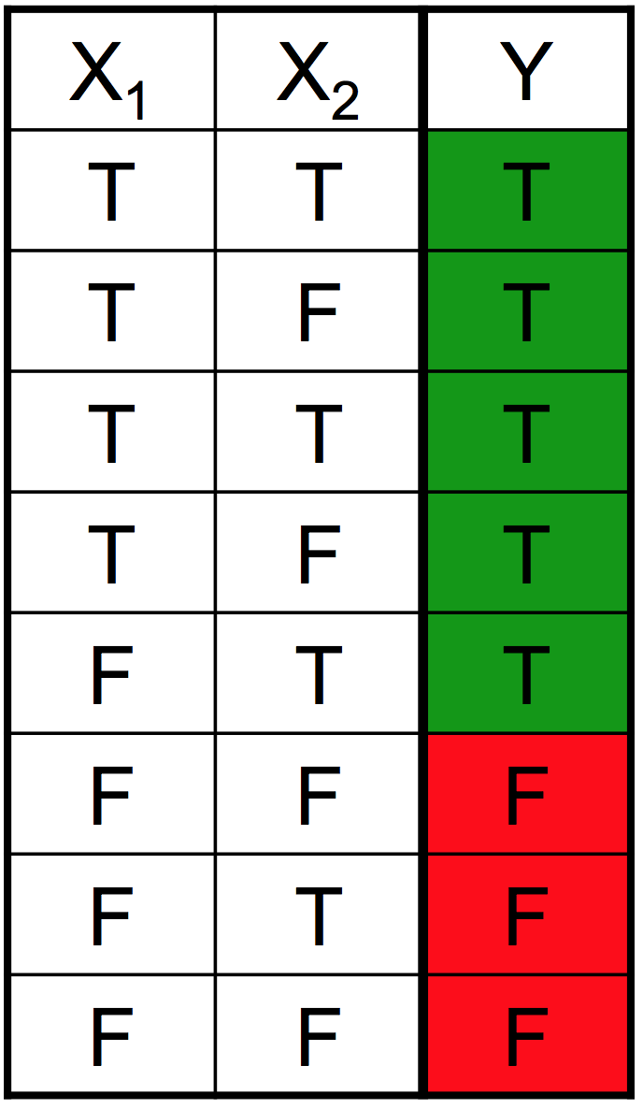
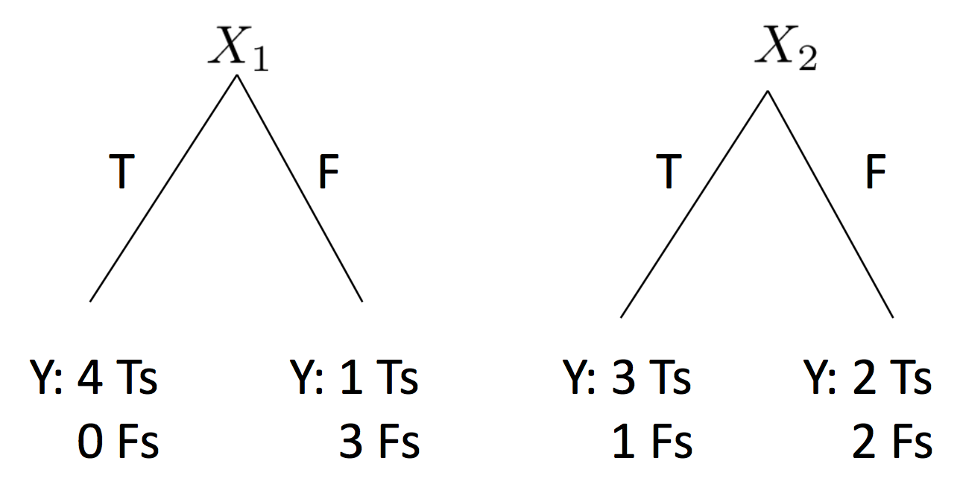
Mutual Information
Used extensively in decision trees: which features to branch on
Pick the feature that yields maximum information gain or I(X;Y) (i.e., biggest drop in entropy)

Slide 17
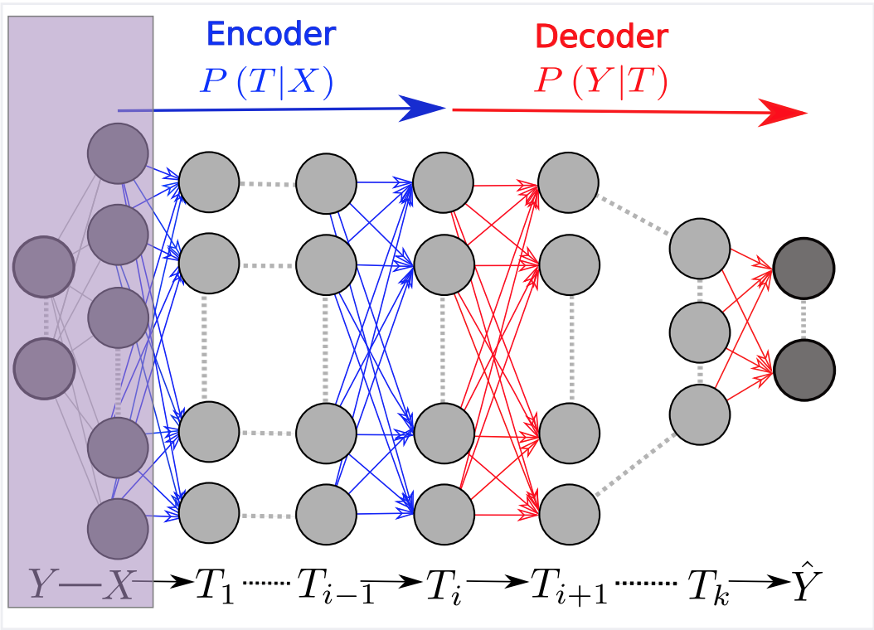
What does this have to do with deep learning?
Multilayer ANNs are [mostly] directed acyclic graphs (DAGs)
Therefore, we can view them as Markov Chains

Slide 18
Notation
X: input
Y: target output
T: intermediate representation
Any T defined as
Encoder P(T|X)
Decoder P(Y|T)
Notes:
information plane coordinates: IX = I(X; T) and IY = I(T; Y ). The Information Bottleneck bound characterizes the optimal representations, which maximally compress the input X, for a given mutual information on the desired output Y . After training, the network receives an input X, and successively processes it through the layers, which form a Markov chain, to the predicted output Yˆ . I(Y ; Yˆ )/I(X; Y ) quantifies how much of the relevant information is captured by the network.

Slide 19

Markov Chains + Mutual Information
Data Processing Inequality (DPI) [Cover and Thomas et al, 2006]
For any three variables that form a Markov chain X -> Y -> Z,
Intuition
Information is generally lost (never gained) when transmitted through a noisy channel
“post-processing cannot increase information”
“garbage in, garbage out”

Slide 20
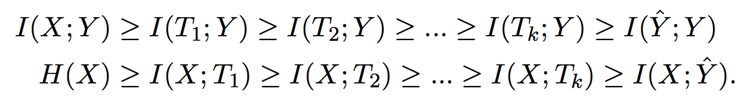
The Information Plane
Given P(X; Y), T is uniquely mapped to a point on the information plane with coordinates [ I(X ; T), I(T ; Y) ].
Notes:
When applied to the Markov chain of a K-layers DNN, with Ti denoting the i th hidden layer as a single multivariate variable, the layers are mapped to K monotonic connected points in the plane - henceforth a unique information path - which satisfies the following DPI chains:

Slide 21
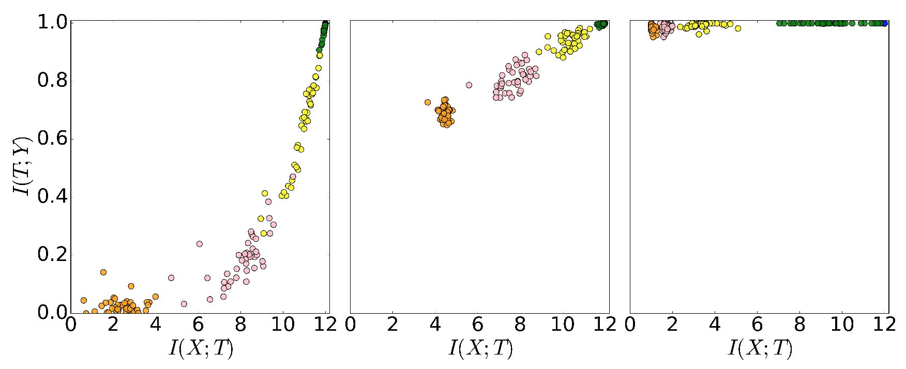
The Information Plane
X-axis: I(X | T) of T encoded in layer i
Y-axis: I(T | Y) of T encoded in layer i
Notes:
Left: initial [random] weights
Middle: 400 epochs
Right: 9000 epochs
As can be seen, at the beginning of the optimization the deeper layers of the randomly-initialize network fail to preserve the relevant information, and there is a sharp decrease in IY along the path. During the SGD optimization the layers first increase IY , and later significantly decrease IX, thus compressing the representation. Another striking observation is that the layers of the different randomized networks seem to follow very similar paths during the optimization and eventually converge to nearby points in the information plane.
Two phases:
- layers increase information on labels while preserving DPI order (lower layers have higher information)
- much longer phase: information on input in layers decreases as they lose irrelevant info until convergence -> representation compression
First phase is not surprising given usual cross-entropy loss function, but second is—no explicit regularization was imposed. – GENERAL PROPERTY of SGD on deep nets

Slide 22
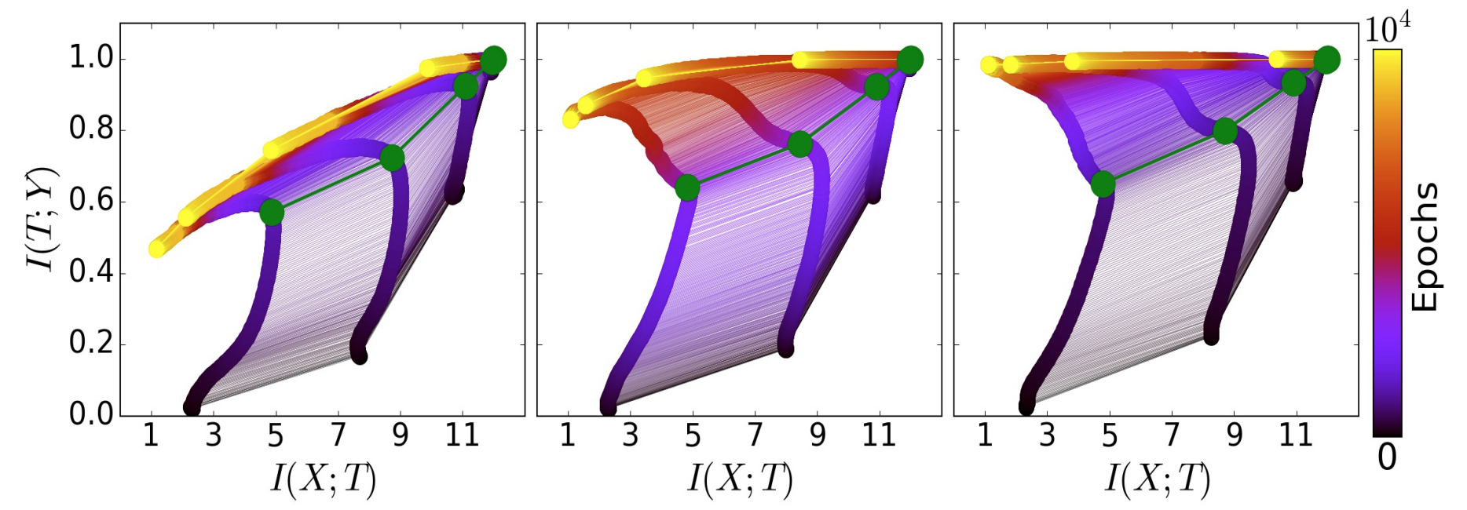
Dual Phases of Training
Most time is spent in the 2nd phase
Notes:
Left: only 5% of data used in training
Middle: 45% of data used in training
Right: 85% used in training
Amount of data affects how quickly transition from 1st to 2nd phase is

Slide 23
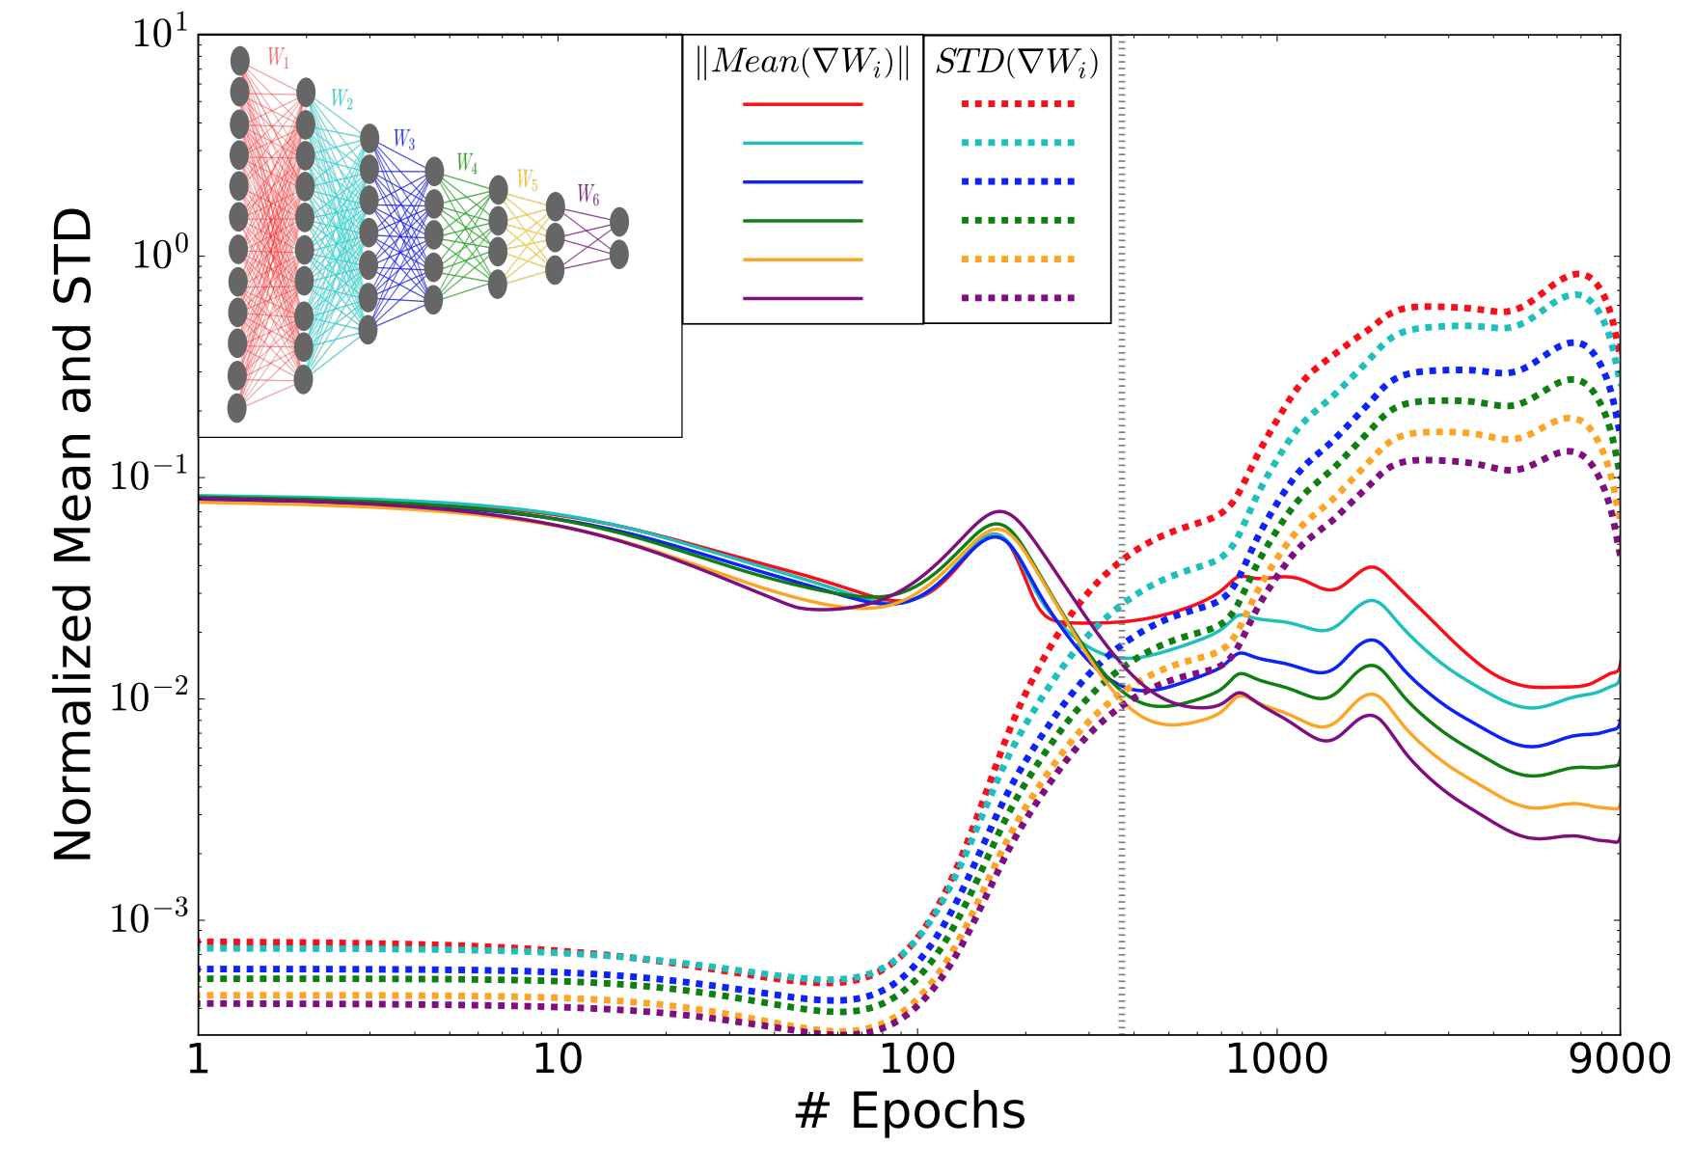
Dual Phases of Training
Phase I: “Drift Phase”
Large gradients
Small variations
Phase II: “Diffusion Phase”
Small gradients
Large inter-batch variations
Notes:
The grey line (∼ 350 epochs) marks the transition between the first phase, with large gradient means and small variance (drift, high gradient SNR), and the second phase, with large fluctuations and small means (diffusion, low SNR). Note that the gradients log (SNR) (the log differences between the mean and the STD lines) approach a constant for all the layers, reflecting the convergence of the network to a configuration with constant flow of relevant information through the layers!
First phase: quickly converge to a representation that maps X to Y as well as possible
Second phase: slowly refine mapping to throw away irrelevant representations of X

Slide 24
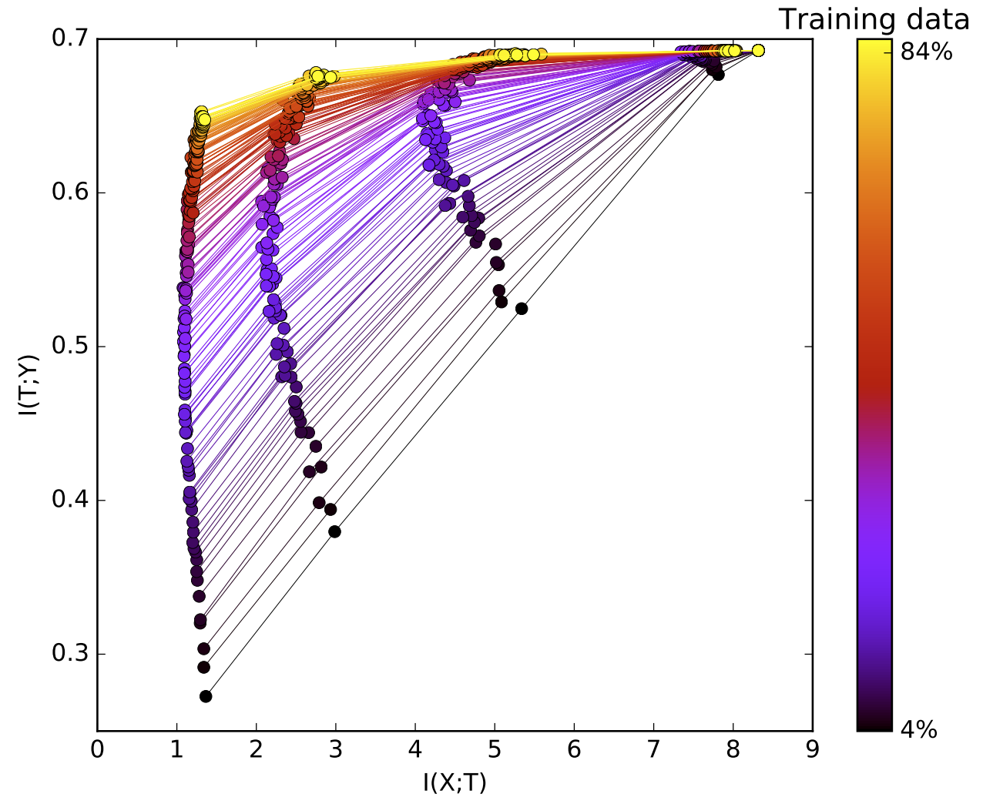
Training Data
Amount of training data affected rate of passage through the two phases
Six points along each line indicate one of the six layers
Averaged over 50 initializations with random weights

Slide 25
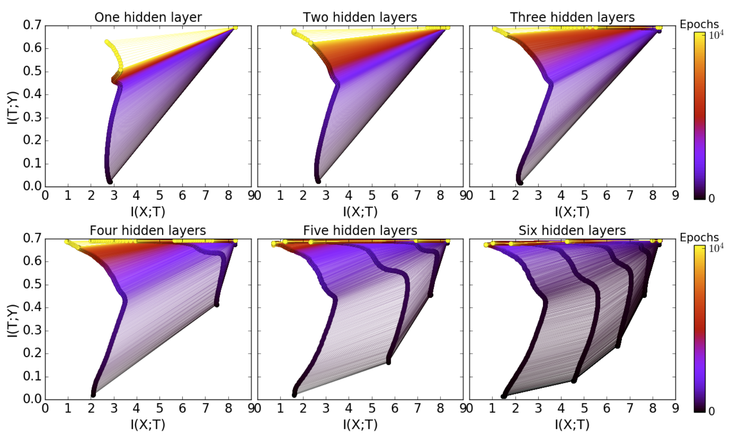
Key Insights
1: Adding hidden layers dramatically reduces the number of training epochs needed for good generalization
Notes:
To see this, compare the color of the paths at the first panels of Figure 5 (with 1 and 2 hidden layers), with the colors in the last panels (with 5 and 6 hidden layers). Whereas with 1 hidden layer the network was unable to achieve good IY values even after 104 epochs, with 6 hidden layers it reached the full relevant information at the output layer within 400 epochs.

Slide 26
Key Insights
2: The compression phase of each layer is shorter when it starts from a previous compressed layer
Notes:
This can be seen by comparing the time to good generalization with 4 and 5 hidden layers. The yellow at the top indicates a much slower convergence with 4 layers than with 5 or 6 layers, where they reach the end points with half the number of epochs

Slide 27
Key Insights
3: The compression is faster for the deeper (narrower and closer to the output) layers.
Notes:
Whereas in the drift phase the lower layers move first (due to DPI), in the diffusion phase the top layers compress first and ”pull” the lower layers after them. Adding more layers seems to add intermediate representations which accelerates the compression

Slide 28
Key Insights
4: Even wide hidden layers eventually compress in the diffusion phase. Adding extra width does not help.
Notes:
It is clear from panels 4, 5 and 6 that the first hidden layer (of width 12) remains in the upper right corner, without lose of information on either X or Y .

Slide 29
Conclusions
The second phase (diffusion / compression) always resulted in a different configuration of weights
Adding hidden layers + Adding more training data both reduce training time required in compression stage
[Un]Surprising Conclusion #1: Many different weight configurations can offer similarly optimal performance
[Un]Surprising Conclusion #2: Looking at a single neuron or weight for insight into network performance is meaningless
Surprising Conclusion #3: Values of weights alone cannot explain generalizability of deep networks
[Un]Surprising Conclusion #4: Data is the best regularizer
Surprising Conclusion #5: Rather than focus on explicit regularization & architectural redesigns, exploit encoder & decoder distributions during training; will yield best convergence rate

Slide 30
Course Details
How is Assignment 5 going? Due today!
How is the project going?

Slide 31
References
“Opening the black box of Deep Neural Networks via Information”, https://arxiv.org/pdf/1703.00810.pdf
Blog post summary https://theneuralperspective.com/2017/03/24/opening-the-black-box-of-deep-neural-networks-via-information/
“Information Theory of Deep Learning” https://www.youtube.com/watch?v=RKvS958AqGY

